Slide 1
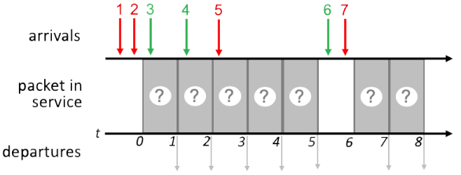
Round Robin Scheduling
IMPORTANT
Assume a round-robin scheduling cycle begins with green packets. i.e., (green, red) in each round
Time 0: 1, 2 in queue, transmit 1
1st round of (green, red). Since there is no green packet ready, this round is (null, red)
Time 1: 2, 3 in queue, transmit 3
2nd round of (green, red)
Time 2: 2. 4 in queue, transmit 2
2nd round of (green, red)
Time 3: 4, 5 in queue, transmit 4
3rd round of (green, red)
Time 4: 5 in queue, transmit 5
3rd round of (green, red)
Time 6: 6, 7 in queue, transmit 6
4th round of (green, red)
Time 7: 7 in queue, transmit 7
4th round of (green, red)
Summary:
Time 0: 1st round: (null, 1)
No green packets ready
Time 1-2: 2nd round: (3, 2)
Time 3-4: 3rd round: (4, 5)
Time 6-7: 4th round: (6, 7)
1
3
2
4
5
7
6
1
3
2
4
5
7
6
1 3 2 4 5 7 6

